Slide 1

Supply Chain Management Project

Slide 2

Project members:
Priti Waghmare
Shubhra Sinha
Om Kadam
Pratik Kate
Preetham K S
Abid Wajid
Md Mahmood Uddin

Slide 3

KPIs Explanation:
These are the main metrics we focused on:
Total Sales: Sales tracked monthly, quarterly, and yearly.
Product Wise Sales: Sales data for each product.
Sales Growth: Comparing sales growth over time.
Daily Sales Trend: Daily sales patterns.
State Wise Sales: Sales data for each state.
Top 5 Store Wise Sales: Performance of the top 5 stores.
Region Wise Sales: Sales data by region.
Total Inventory: Overall inventory levels.
Inventory Value: Financial worth of the inventory.
Stock Status:
In-stock: Inventory in hand >= 0
Out-of-stock: Inventory in hand < 0
Under-stock: Inventory in hand < Stock quantity
Purchase Method Wise Sales: Sales by different purchase methods.

Slide 4
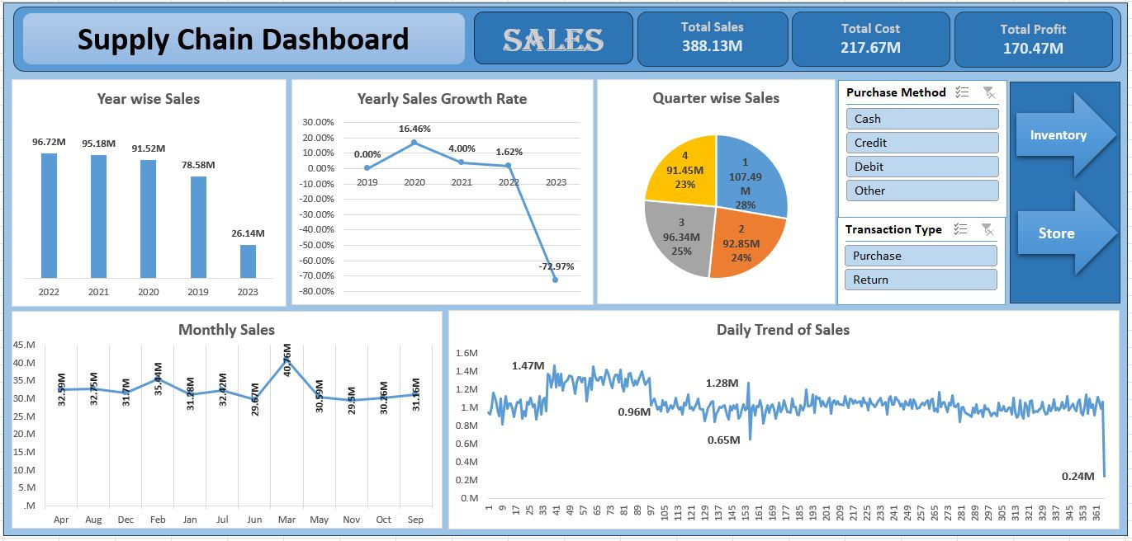
MS Excel Dashboard

Slide 5
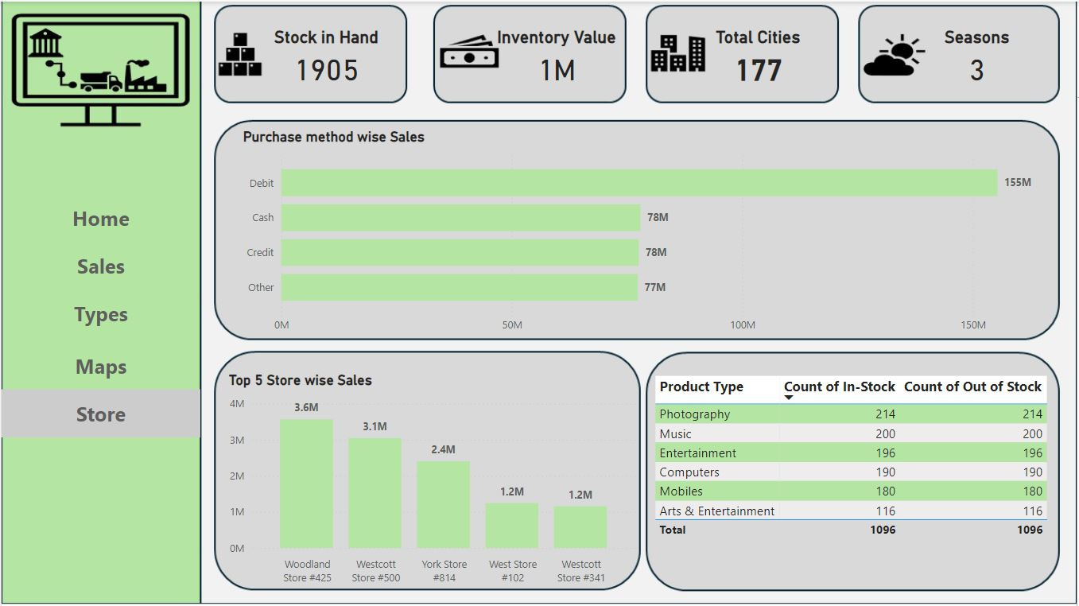
Power BI Dashboard

Slide 6
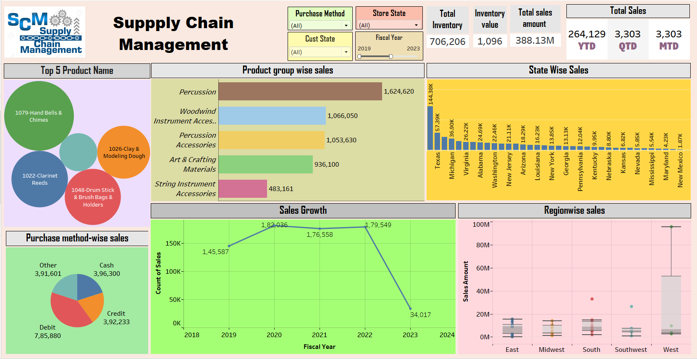
Tableau Dashboard

Slide 7
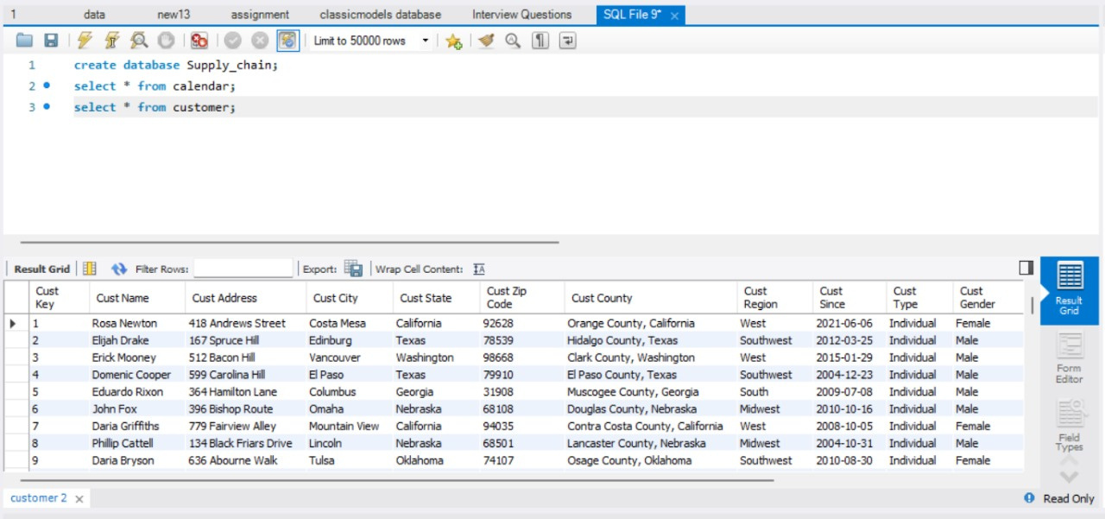
SQL

Slide 8

Learning Outcomes
What We Learned:
Data Integration: Combining data accurately using SQL.
Data Visualization: Creating clear and useful dashboards with Tableau and Power BI.
Analytical Skills: Better at analyzing complex data.
Collaboration: Working well as a team.
Project Management: Planning and managing the project efficiently.
Problem-Solving: Finding solutions to data challenges.
Decision-Making: Making better decisions based on data.

Slide 9

Conclusion
The company maintains a balanced inventory across 177 cities, with strong sales performance across multiple payment methods. Top stores like Woodland #425 significantly outperform others, suggesting opportunities for replicating their success. The even distribution of in-stock and out-of-stock items across product categories indicates effective inventory management. Overall, the data reveals a well-managed operation with potential for targeted improvements in underperforming areas.

Slide 10




Overall Experience
This project was a great learning experience. We learned a lot about supply chain management and how to make data-driven decisions. Working as a team helped us share our skills and grow professionally. This experience will be very useful in our future careers.

Slide 11
Thank You

